Slide 1
Data Link and Physical Layers

Slide 2
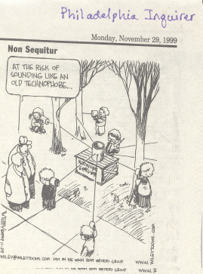

Slide 3
Data Link and Physical Layers
Data Link
  Logical Link Control
  Medium Access
Physical
  Still protocols, not the physical cable

Slide 4
Medium Access Control
Contention based vs. controlled access
Contention
  Aloha, Ethernet (IEEE 802.3)
Controlled access
  Token based protocols (token ring, token bus)

Slide 5
Goals:
Minimize Wait
Maximize use of resources
These are often conflicting goals. If the customer never has to wait at all, we will probably have servers idle some of the time. If the servers are always busy, customers will have to wait sometimes.
The trick is to compromise in such a way that service is good and resources are well used.

Slide 6
Aloha
One central site and many satellite sites
Satellite sites cannot hear each other’s transmissions -- all go through the central site.
If two or more of the satellite sites transmit at the same time, the transmission is garbled and completely lost

Slide 7
Aloha model
Remember, any overlapping
transmission means failure.

Slide 8
Can this possibly work?
What is the probability of successful communication under these conditions?
First, we need to understand what is required for success:
  A transmission must begin while no other transmissions are active
  No other transmission may begin while this one is active.

Slide 9
Probability of success
Let’s call the duration of the transmission t
We need to be sure that, at the time we start to transmit
  no other station has started transmitting within the previous time interval, t, and
  no other station will start transmitting for a time interval, t, after we begin to transmit.
How can we possibly know what the other stations have done or will do?

Slide 10
A probability model
This is not an uncommon problem. To predict the number of servers needed in a restaurant or a store, someone has to predict how many people will show up in certain periods of time. The problem has been studied and there are well-analyzed models.
The Poisson model is good at analyzing potential results of some kinds of unpredictable events over time.

Slide 11
Poisson
The Poisson distribution predicts the number of events to occur in a time period.
 = the arrival rate = the number of frames per unit of time
t = time duration
k, n = numbers of frames (events, in general)
The Poisson distribution is P_{n}(t) = (t)^{n} e^{- t} /n!
So, if we know the rate of occurrence of some event, we can predict the likelihood of exactly n occurrences in a period of time = t
Note that the occurrences are random, not regularly scheduled.
There will be periods of time with no occurrences, and others with many occurrences.

Slide 12
Examples of the Poisson model
Suppose a new piece of equipment has a rate of failure of 2 per 1000 hours. What is the probability of 2 failures in a single hour?
=2/1000; n=2; t=1 hour
P_{n}(t) = (t)^{n} e^{- t} /n!
P₂(1) = (2/1000 * 1)² e^{- 2/1000 * 1} /2!
P₂(1) = 0.00000199600399733467

Slide 13
Poisson model for Aloha
P_{n}(t) = (t)^{n} e^{- t} /n!
 is the rate at which frames are sent
t is the time under consideration
n is the number of frames sent in the time period.
We need 0 frames sent (by others) in a period 2t
P₀(2t) = (2t)⁰ e^{- 2t} /0! = e^{- 2t}

Slide 14
Probability of success
The probability of success will clearly depend on the amount of traffic
  arrival rate and time remain in the equation
P₀(2t) = (2t)⁰ e^{- 2t} /0!
G = t is called the offered load and is a measure of how busy the resource is.
P₀(2t) = (2G)⁰ e^{- 2G} /0! = e^{- 2G}
So, the probability of success for our transmission is e^{- 2G}

Slide 15
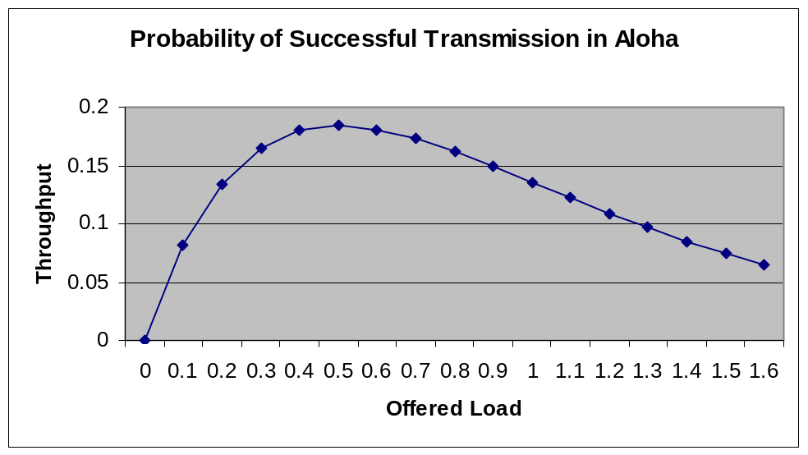
Throughput
Throughput (S) is a measure of how well we serve the actual
load on the system.
S=G e^{- 2G} = The offered load times the probability of delivering the frame successfully
The value of G when the slope turns down is 0.183939721
Aloha works perfectly well as long as the traffic offered is not more than 18.4% of capacity

Slide 16
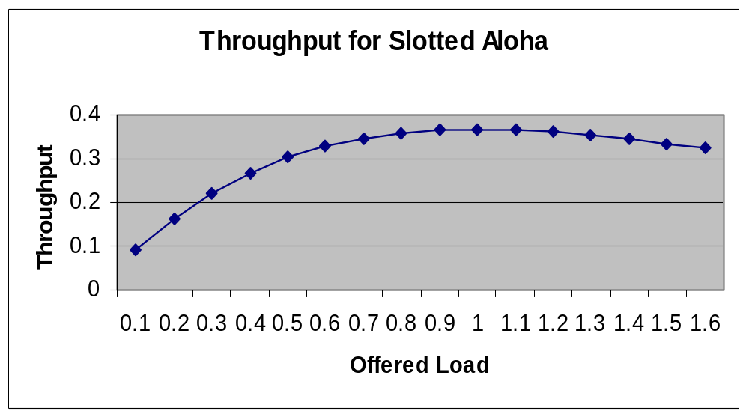
Aloha and its descendants
Pure aloha:packet vulnerable for two times the packet transmission time
Slotted aloha: reduced the vulnerable period to one times the packet transmission time: S=G e^{- G}
Throughput drops off at G = 1;
max value is 0.367879
usage limited to 36.8% of capacity

Slide 17
Improving performance
Slotted aloha allows use of more of the capacity of the data channel at the cost of more wait for the senders.
  Even if no one else is transmitting, the would-be sender must wait for the next slot boundary.
  Balance overall efficiency of the system with needs of the individual users
Problem was that the stations could not hear each other’s transmission. What happens if we fix that?

Slide 18
CSMA: Carrier Sense Multiple Access
Also called “Listen Before Talk”
  listen; if channel clear, transmit; otherwise wait
vulnerability reduced to the time it takes most remote system to know about a transmission
  depends upon the fact that propagation delay is much less than transmission time
variations:
  non persistent
  p-persistent
  1-persistent
Still don’t know about interference that occurs during transmission due to almost simultaneous transmissions by several stations.

Slide 19
Add Collision Detection
CSMA/CD or “Listen While Talk”
requires the sender to listen as long as needed to detect any possible collision
requires a recovery process
  binary exponential backoff
Scalability problem: throughput decreases as transmission rates increase.
Simplicity in initialization, station addition and deletion, fault management
This is Ethernet/IEEE 802.3

Slide 20
Ethernet/IEEE 802.3
Bytes
field
7 1 2/6 2/6 2 46-1500 4
Preamble SFD DA SA L Data FCS
Preamble: 56 bits alternating 10 used to synchronize the receiver
SFD: Start Frame Delimiter. 10101011 to signal beginning of
the transmission
DA/SA: Destination and Source Addresses
L: Length of the data part
Data: Minimum length required for proper operation. Padding
used if needed
FCS: Frame Check Sequence: Extra bits appended for error
checking: the CRC

Slide 21
Ethernet specification
Maximum frame size:
  1518 bytes not counting the 8-byte preamble
  1526 bytes counting everything
Minimum packet size:
  72 bytes counting the preamble
Minimum packet spacing:
  9.6  seconds between end of one transmission and beginning of next

Slide 22
Scaling
What happens if the 10Mbps Ethernet is changed to 100Mbps?
  Bit speed does not change; what does?
    How big is a bit?
    Speed of light is 299,792,458 meters per second
    transmission of data cannot quite achieve that, but comes fairly close.
    Assume .8 * speed of light for the speed of the electrons representing our bits.
    Let’s make life easier by using round numbers:
    300,000,000 meters per second for light; .8 times that for the bits; 100Mbps = 100 Million (not the proper power of 2)
    So, how big is a bit? How big is a bit at 10 Mbps?

Slide 23
Scaling, mathematically speaking
Throughput is the reciprocal of the average time required to launch a message successfully:
m is the time needed to transmit the message
☺ is the time to travel the entire length of the network.
Worst case time to detect collision = 2☺
If average number of retransmissions is J,
  then 2 ☺ J time is required to resolve the collision
Average time required to launch a message successfully is then m + ☺ + 2 ☺ J.
The only unknown is J, the average number of retransmissions.
v = probability of success after one attempt to transmit
(1-v)v = probability of success after two attempts….
(1-v)^{k-1}v = probability of success after k attempts, etc.
Average number of retransmissions required is sum over all k of k*probability of success after k tries:
J = v(1-v) ^{k-1} = 1/v
k=1,∞

Slide 24
Scaling, continued
J = k v(1-v) ^{k-1} = 1/v
k=1,∞
Probability that a station wants to transmit in a 2☺ interval is p
The probability that exactly one station transmits and is successful is
v= n p(1-p)^{n-1}
Maximum v occurs when p = 1/n and thus
v_{max} = n(1/n)(1-1/n)^{n-1} = (1-1/n) ^{n-1} --> e⁻¹, n--> ∞
So, J = 1/v --> e and
t = m(1+a(1+2J)) = m(1+a(1+2e))
time to launch a message successfully is t = m(1+6.44a)

Slide 25
Scaling: the bottom line
t=m(1+6.44a)
S = m/t_{v} =<= 1/(1+6.44a) ; a= ☺/m
This is the bottom line. Throughput is dependent on a; a is
the ratio between the time it takes to reach the farthest removed
station and the length of time it takes to transmit the message.
This shows that if we decrease the length of time it takes to launch
a message (by increasing the transmission speed), we increase a
and decrease throughput. To compensate, we have to reduce the
maximum propagation delay -- which can only be done by making
the longest cable distance smaller.
That is why 100 Mbps Ethernet have shorter distance restrictions

Slide 26
The Token Ring
Controlled access; no collisions to resolve
Having a token requires a way to recover from token loss -- a monitor

Slide 27
Token Ring Frame Format
1 1 1 2/6 2/6 <5000 4 1 1 bytes
SD AC FC DA SA LLS FCS ED FS field
SD = START DELIMITER
ED = END DELIMITER
AC = ACCESS CONTROL
FC = FRAME CONTROL
SA/DA = SOURCE/DESTINATION ADDRESSES
FS = FRAME STATUS
FCS = FRAME CHECK SEQUENCE
Token = SD AC ED

Slide 28
The token
start delimiter: JK0KJ000
    J, K are signals that cannot be mistaken for 0 or 1
end delimiter: JK1JK1IE
    I for intermediate (1) or last (0)
    E for error detected
Access Control: PPPTMRRR
    PPP: priority
    T: token (1) or data frame (0)
    M: monitor has seen this (1) or not (0)
frame control : FFZZZZZZ
    identifies the frame as MAC or LLC
    allows the MAC and LLC protocols to communicate with peers

Slide 29
Token Ring continued
Source and destination addresses
  16 or 48 bits, first bit indicates individual or group address; same standard as ethernet
FCS: Frame check sequence (CRC)
Frame status: ACxxACxx
  Address recognized
  Frame Copied to host
Scalability
  same problem as CSMA/CD

Slide 30
FDDI
Similar to Token Ring, but with differences to help it scale
  Five bit codes to represent four data bits
  latency: each station must receive 10 bits before passing on
  No designated monitor
responsibilities shared by all the interface units
Early token release

Slide 31
DQDB
IEEE 802.6 (MAN)
Two unidirectional buses
communicate by inserting message into the first available slot
slots are 53 octets to match ATM technology
Though it is accepted as a standard, some fairness problems remain and are the subject of current study

Slide 32
Error Control
Error detection vs. error correction
  detection is relatively easy; correction comes with high cost
Block parity check
  Arrange the bits in a two-dimensional array, perhaps one character per row and some number of characters giving the number of rows.
  Use a parity bit for each row and one for each column
  vulnerable to burst type errors, which are common
Polynomial encoding -- the CRC, for example
  Very reliable, but not perfect

Slide 33
CRC
The basic idea: choose a divisor, send a value that is known to be evenly divisible by the divisor.
Also send the modification to the original data that made it evenly divisible.
Receiver checks the division. If any remainder, the transmission contains an error.

Slide 34
CRC polynomial
Interpret the bits to be sent as the coefficients of a polynomial:
  0001010010 represents
  0x⁹ + 0x⁸ + 0 x⁷ + 1x⁶ + 0x⁵ + 1x⁴ + 0x³ + 0x² + 1x¹+ 0x⁰
Agree on a common polynomial to divide by such that the remainder will be 0
Shift the polynomial by the degree (n) of the common polynomial divisor (multiply the data polynomial by x^{n} )
Divide, then subtract the remainder from the shifted polynomial before transmitting.
Receiver verifies that division yields no remainder and can easily see the original data by dropping off the extra bits

Slide 35
CRC checking
Append 0s to the data --- as many as the degree of the divisor polynomial
Divide
Subtract the remainder from the augmented polynomial and transmit.
Example:
  data = 0010100100101010010101001001; generator polynomial = 100101

Slide 36
Framing
Flags and bit stuffing
  flag = 01111110
  bit stuffing = make sure the flag does not occur anywhere in the actual data transmitted
    Whenever the sender sees a pattern of five consecutive 1's, insert a 0.
    Whenever the receiver sees a pattern of five consecutive 1's followed by 0, delete the 0.
Physical layer coding violations
  using something other than the agreed representation of 1 or 0 and giving it a special meaning. (the J and K in the token ring start delimiter, for example)

